Slide 1

UFO Sightings Database Project
Led by: Adegbite,
Ayoade Abel

Slide 2
Web Scraping from NUFORC website
Our data will be scraped from Data Bank page of the National UFO Reporting Center (Dedicated to the collection and dissemination of objective UFO data) into Excel and pushed to a database system (MySQL, MSSQL Server and PostgreSQL).
It will be publicly available on this GitHub Page

Slide 3

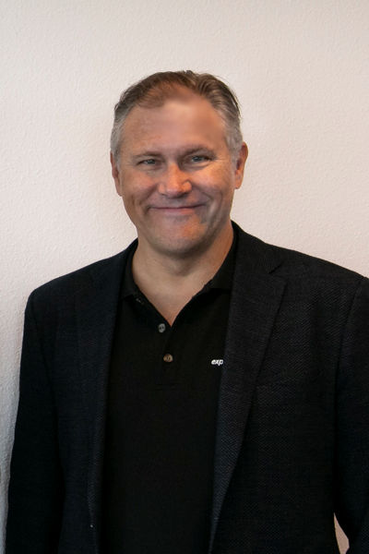
About NUFORC
The National UFO Reporting Center was founded in 1974 by noted UFO investigator Robert J. Gribble.
The Center’s primary function over the past four decades has been to receive, record, and to the greatest degree possible, corroborate and document reports from individuals who have been witness to unusual, possibly UFO-related events.
Throughout its history, the Center has processed over 150,000 reports, and has distributed its information to thousands of individuals.
The principal means used by the Center to receive sighting reports is this website, which has operated continuously since 1994.
Prior to that period, the telephone hotline and the U.S. mail were the primary means of taking reports.
Center Director
Technical Director

Slide 4
Why UFO Sightings though ?
I was going through google and a news article caught my attention.
Voila, it was about UFO sighting and right there I decided I want to explore the dataset available for UFO sightings to see the most frequent locations so I can go there and I will probably see one myself 😂😂😂😂😂
Link 1 : Stopped at 9/9/2013 23:30
Link 2 : Stopped at 9/9/2013 23:00
Link 3 : Stopped at 8/19/2021 18:00

Slide 5
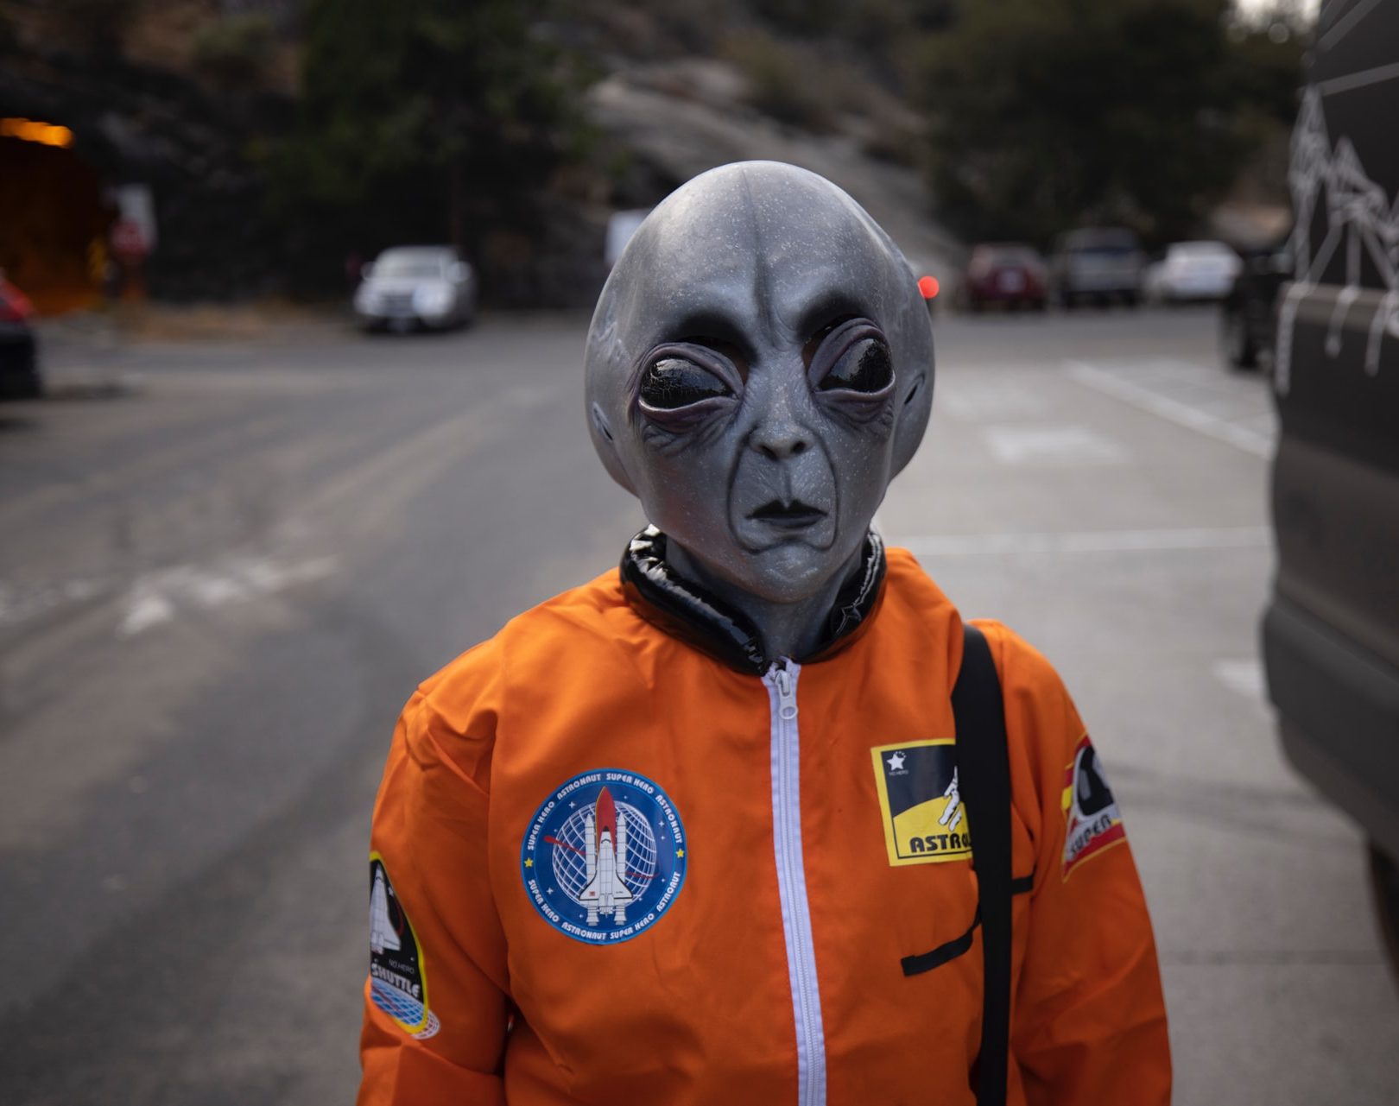
THANK YOU

